Slide 1
RUNGTA COLLEGE OF DENTAL SCIENCES & RESEARCH
TITLE OF THE TOPIC- ENDODONTIC SURGERY
DEPARTMENT OF – CONSERVATIVE DENTISTRY AND ENDODONTICS

Slide 2
Specific learning Objectives
At the end of this presentation the learner is expected to know ;
Core areas* | Domain ** | Category #
Introduction | Cognitive | Must know
Method | Psychomotor | Must know
Armamentarium | Cognitive | Must know
*Subtopic of importance
** Cognitive, Psychomotor or Affective
# Must know , Nice to know & Desire to know
( Table to be prepared as per the above format )

Slide 3
TABLE OF CONTENTs
Definition
Indication
Contraindication
Classification
Anatomic consideration
Patient preparation
Surgical access
Haemostasis
Root end resection and preparation
Root end filling
Flap closure and suture
Postoperative complications

Slide 4
Microsurgery - A surgical procedure on exceptionally small and complex structures with an operating microscope
Root-end resection (also named endodontic surgery, periradicular surgery, periapical/apical surgery or apicoectomy) consists of surgical removal of a periapical lesion, resection of the apical portion of the root, disinfection and sealing of the apical portion of the remaining root canal (Gutmann 1991).
Patient preparation
Surgical access
Root end resection and preparation
Flap closure and suturing
Soft tissue access
Hard tissue access

Slide 5
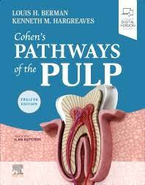
Indications for Endodontic Microsurgery
Adequately executed endodontics but failed with a persistent periapical radiolucent lesion.
Adequately executed endodontics with constant pain with or without swelling
Apical transportation, ledges and other iatrogenic problems with persistent pathology and symptoms
Tooth with a large post and crown restoration completed, especially maxillary anterior teeth
Calcified canals with or without symptoms and PAR (periapical radiolucency)
Broken instrument in apical half of the root
Failed traditional surgery
Overfilled canal with PAR
Complex/compound apical curvatures that are inaccessible from an orthograde aproach
lesion not healing non surgically
long posts or irretrievable separated instruments,
nonnegotiable ledges and canal blockages or transportation
hard cement filling materials
failure of previous nonsurgical retreatment
suspected vertical root fracture
when a biopsy is indicated .
Surgery may be the first choice even if a tooth can be treated nonsurgically, if the risks and costs of retreatment are considered excessive.

Slide 6
Contraindications of surgery
THEY ARE NOT ABSOLUTE-determined by the limitations of endodontic surgical technique,patient’s medical condition.
1.ANATOMIC FACTORS-
proximity to neurovascular bundles eg-mandibular second premolars,first molars.
Second mandibular molar area-buccal plate is thick,roots lingually inclined and apices close to mandibular canal.more restricted access.
Proximity to maxillary sinus-maxillary premolars,molars.
2.PERIODONTAL CONSIDERATIONS-if tooth has periodontal defects, success of endodontic surgery is compromised(eg.short rooted tooth with deep periodontal defect likely to cause endo/perio communication)
3.MEDICAL FACTORS-patients with leukaemia and neutropenia in active state,severly diabetic, patient with recent cardiac surgery,cancer surgery,older ill patients (not for all old patients).
4.POSTPONEMENT OF SURGERY-pt is recovering from MI,taking anticoagulants,-consulatation necessary,radiation treatment of jaw,(chances of osteoradionecrosis),in first trimester.
5.SURGEON’S SKILL&ABILITY

Slide 7
Class A, B and C present no significant treatment problems, and the conditions do not adversely affect treatment outcomes.
However, class D, E and F present serious difficulties and require not only endodontic microsurgical techniques but also current periodontal surgical techniques (e.g., the membrane barrier technique).
Ref- Kim S, Kratchman S. Modern endodontic surgery concepts and practice: a review. Journal of endodontics. 2006 Jul 1;32(7):601-23.

Slide 8
Anatomic Considerations
Evaluating the access to the surgical site is one of the most important steps in case selection for periradicular surgery.
Cohen 12th edition

Slide 9
Posterior Mandible
The primary anatomic structure of concern in the posterior mandible is the
neurovascular bundle that courses through the mandibular canal and exits through the
mental foramen.
The depth of the vestibular fornix generally is a good predictor of the possible difficulty involved in obtaining surgical access to the mandibular posterior teeth. A shallow vestibule usually portends thicker alveolar bone and more difficult access to the root end.
In the buccolingual dimension, the mandibular canal follows a curving pathway from the buccal half of the mandible near the distal root of the second molar to the lingual half of the mandible near the first molar, then curving back to the buccal near the second premolar as it exits the mental foramen
The average vertical distance from the superior border of the canal to the distal root apex of mandibular second molar is approx 3.5mm and increases gradually to approx 6.2mm for first molar and 4.7mm for sec premolar.This relationship typically provides a greater margin of safety for surgery on the mandibular first molar compared with the second premolar and especially the second molar.
Relationship between the apices of the lower molars and mandibular canal-a radiographic study M. M. Littner, D.M.D.,*

Slide 10
The thickness of the posterior buccal cortical plate is generally 2—.3 mm on average, this thickness may increase posteriorly (oblique ridge) limiting access to the molar roots .
While premolar roots and the mesial root of the mandibular first molar are reasonably close to the facial cortical plate, the distal root of the mandibular first molar is centrally located in the bone, and the roots of the second and third molar art significantly closer to the lingua! cortical plate.
Final area of consideration in the mandibular posterior region is the presence of high muscle attachments in the premolar area .
These attachments will directly affect flap design, tissue replacement, suturing, and postoperative healing.
Surgery on the mandibular second
molar may be further complicated by relatively thick overlying buccal bone,
lingual inclination of the roots, and a more buccal location of the mandibular
canal. This is not to say that periradicular surgery should not be performed on mandibular second molars; rather, it points out that the relative risks and benefits must be carefully considered.

Slide 11
Mental Foramen
Location
Many studies have investigated the position of the mental foramen (MF) by examining collections of dried skull cadavers, clinical radiographs, and more recently CBCT.
These studies revealed that the mental foramen is most frequently located by the apex of the second mandibular premolar or less frequently near the apices of the first premolar and the first molar
On average, the MF is 5.0 mm from the closest root (the range is 0.3–9.8 mm); however, the MF may even be located at the same level or even coronal to the apices of adjacent roots in a rare situation
Periapical Surgery of Mandibular Posterior Teeth: Anatomical and Surgical Considerations Louis Lin,

Slide 12
Vertical location of the mental foramen may vary even more than horizontal location. Moiseiwitsch found that the average location was 16 mm inferior to the cementoenamel junction (CEJ) of the second premolar, although the range was 8 to 21 mm, which would place approximately 20% of the foramina at or coronal to the root apex.
Fortunately, the mental foramen usually is easily visualized with standard periapical and panoramic radiographs.
A vertically positioned periapical radiograph often may be more useful than a horizontally positioned one, especially in individuals with longer roots. Also, the mental foramen usually can be palpated.

Slide 13
NOTE
For the vertical distance between the SAL and the MC, at least 2 mm of bone should be present to safely performa 4-mm-diameter osteotomy.
According to this study, 4.2%, 1.7%, and 1.5% of the SALs of the mandibular second premolars and the distal and mesial roots of the mandibular first molars were less than 2 mm from the MC, respectively.
These results indicated that most cases in this study presented a safe distance between the SAL and the MC.
However, the cases in which the distance between the SAL and the MF and MC was less than 1 mm posed a great challenge for protecting nerves from injury.
Relationship between the Mental Foramen,
Mandibular Canal, and the Surgical Access Line
of the Mandibular Posterior Teeth: A Cone-beam
Computed Tomographic Analysis
Xiuyou Wang, JOE 2017

Slide 14
NOTE
The retractor cannot be placed in the space between the MF and the SAL unless the osteotomy diameter is reduced to 3 mm, which is a considerable challenge for most surgeons.
If 2 mm of bone remains between the MF and the SAL, then the likelihood of proper retractor placement improves because 1 mm of bone is available between the MF and the inferior edge of the osteotomy, and the retractor can be placed in between those areas.
Despite these precautions, the mental nerve can still be easily
injured. In summary, cases with less than 2 mm between the MF and the SAL require more attention and preparation before surgery
Relationship between the Mental Foramen,
Mandibular Canal, and the Surgical Access Line
of the Mandibular Posterior Teeth: A Cone-beam
Computed Tomographic Analysis
Xiuyou Wang, JOE 2017

Slide 15
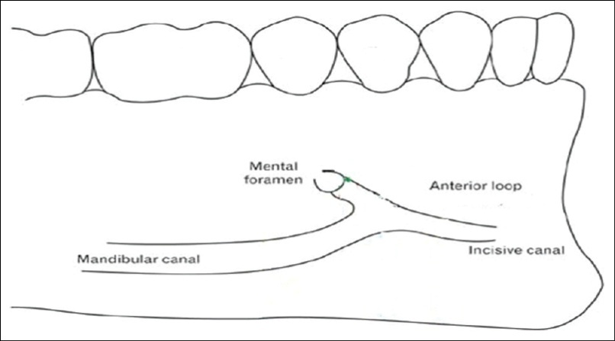
ANTERIOR LOOP
The anterior loop (AL) is an extension of the mandibular canal mesial to the MF and curving backward before exiting the MF. Its size or how often it occurs is not well known.
During periapical surgery of mandibular premolars, the possible presence of an anterior loop should always be considered.
Again, a CBCT is a reliable tool in determining the extension of the loop.
The anterior loop has been found up to 2.63 mm long, which is consistent with a 3-mm safety margin necessary to avoid damage to the MN in apical surgery.
Kim : microsurgery in endodontics

Slide 16
Number of Mental Foramina
The mandibular nerve can bifurcate in the inferior superior or medial lateral plane.
Thus, a bifurcated mandibular nerve will have more than one mental
foramen.
Accessory mental foramina (AMF) (Figure 15.3) are rarely observed with periapical or panoramic radiographs because the size is generally less than 1.0 mm, but they can be observed with a CBCT.
When an AMF is seen on CBCT, caution should be given not to damage
Kim : microsurgery in endodontics

Slide 17
When a vertical releasing incision is indicated, it typically is made at the mesial line angle of the mandibular canine. This location is always mesial to the mental foramen, because the foramen is located in the area ranging from the apex of the mandibular first premolar to slightly distal to the second premolar. The nerve bundle exits from the foramen in a distal direction.
An alternative technique for gaining access to mandibular posterior teeth involves a distal releasing incision between the mandibular first and second molars. This approach may be especially useful for access to the mandibular second premolar and first molar
Care must be taken to avoid the facial artery as it crosses the level of the inferior vestibular fornix near the mandibular first molar. Inadvertent contact with the facial artery is unlikely if the incision is not extended beyond the depth of the vestibule.
Periapical radiographs taken from two vertical angulations, 0 degrees (parallel technique) and −20 degrees, may help determine the buccolingual position of the canal in the same way horizontally angled radiographs may differentiate between buccal and lingual roots.
Cone-beam computed tomography (CBCT) imaging can be very useful for identifying the location of the mandibular canal and determining its relationship to the root apices

Slide 18
Groove Technique Using Piezoelectric Surgery
Piezosurgery is useful when the bone must be cut close to important soft tissue areas, such as the mental neurovascular bundle.
The retractors for periapical surgery should have serrated working ends to provide better anchoring on the bone and prevent slippage during retraction.
Kim : microsurgery in endodontics

Slide 19
Posterior Maxilla
The primary anatomic structure of concern in the posterior maxilla is the maxillary sinus. Perforation of the sinus during surgery is fairly common, with a reported incidence of about 10% to 50% of cases
The sinus membrane usually regenerates, and a thin layer of new bone often forms over the root end, although osseous regeneration is less predictable
If the maxillary sinus is entered during surgery, special care must be taken to prevent infected root fragments and debris from entering the sinus.
A sinus opening can be temporarily occluded with a material such as Telfa gauze(3" x 4" Non-Adherent Sterile Gauze Pads are highly absorbant, non-woven, cotton bonded on both sides with a perforated no stick film. These pads are meant for cleaning and dressing minor cuts, scrapes or burns), although the gauze should be secured to prevent inadvertent displacement into the sinus
Jerome and Hill suggested securing the apical root segment by drilling a small hole in the root tip and threading a piece of suture material through the hole. The root is then resected at the appropriate level, and the root-end fragment is removed in one piece.
If a root fragment or other foreign object is displaced into the sinus, it should be removed. An orascope or endoscope may be useful for visualizing the foreign object, but referral for evaluation and surgical removal may be indicated if the fragment cannot be located and removed.

Slide 20
In a study that measured mean distances between maxillary posterior teeth apices and the maxillary sinus floor and between the apices and the adjacent lateral bony surfaces using CT display data from 12 autopsy specimens and 38 human subjects, the apex of the maxillary second molar mesiobuccal root was found to be closest to the sinus floor (mean: 1.97 mm) and farthest from the buccal bony surface (mean: 4.45 mm), whereas the apex of the maxillary first premolar buccal root was found to be closest to the adjacent lateral bony surface (mean: 1.63 mm) and farthest from the sinus floor (mean: 7.05 mm).
Eberhardt JA, Torabinejad M, Christiansen EL. A computed tomographic study of the distances between the maxillary sinus floor and the apices of the maxillary posterior teeth. Oral Surg Oral Med Oral Pathol
other study found the first premolar root tip to be farthest and the second molar buccodistal root tip to be closest to the sinus floor on both right and left sides.

Slide 21
Major anatomical considerations
On the buccal aspect of the maxillary posterior arch, the major considerations include the malar (zygomatic) process, exostosis , muscle attachments and the maxillary antrum.
Often, the malar process is directly above or overlies the apex of the mesiobuccal root of the maxiilary first molar
Ironically, this root is the frequent subject of surgical endodontics due to its anatomical canal variations (Biorndal & Skidmore, 1983).
The process consists of thick dense bone, and flap retraction and access to the root may be impeded. & there may be difficulty in discerning the proper outline of the root within its dense bony housing..

Slide 22
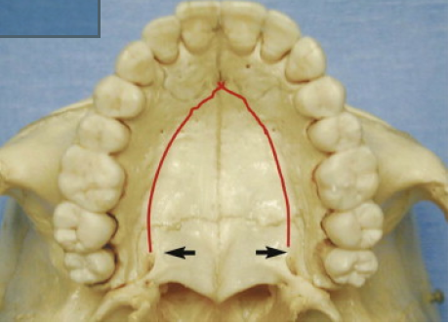
The palatal roots of maxillary molars present a special challenge for surgical access. Palatal roots may be reached from either a buccal (transantral) or palatal approach.
Wallace described a transantral approach in which a buccal flap is reflected, the buccal roots are resected, the osteotomy access into the sinus is enlarged to approximately 1 × 1.5 cm, and the palatal root tip is resected, ultrasonically prepared, and filled.
The sinus may be packed with moist gauze to catch debris, and it should be irrigated with sterile saline upon completion of the surgery.
Palatal approach may seem more direct But Visibility in the surgical field is reduced, and manipulation of instruments is more difficult than with most routine buccal approaches
Patients with a deep, vertical palatal vault are better candidates for this approach than individuals with a wide, shallow palate. A sinus tract or a large lesion on the palatal root may allow easier access and better visualization of the palatal root because only limited bone removal would be required.
The position of the anterior palatine artery must be carefully considered when the incision is made and the flap reflected.
If the anterior palatine artery is severed, local clamping and pressure may not stop the hemorrhage, and ligation of the external carotid artery may be necessary
Palatal view showing the position of the greater palatine foramen (arrows). The approximate location of the anterior palatine artery is marked in red.

Slide 23
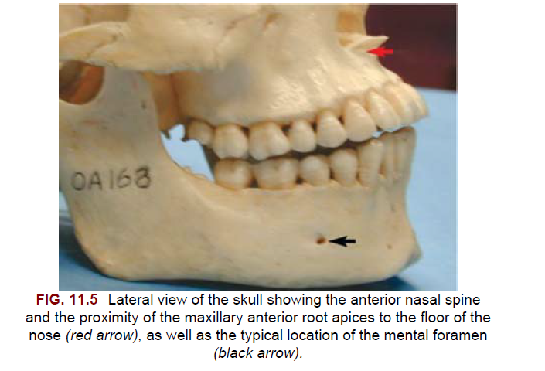
Anterior Maxilla and Mandible
Periradicular surgery on anterior teeth generally involves fewer
anatomic hazards and potential complications than in posterior teeth.
Long roots, a shallow vestibule, or lingual inclination of the roots the root apices of maxillary central and lateral incisors can be quite close to the floor of the nose and the bony anterior nasal spine.
The average maxillary canine is about 26 mm long and usually presents no difficulty for surgical access, but the combination of a shallow vestibule and a longer-than-average root length could complicate access to the root apex area.
An alternative approach for long-rooted teeth and root tips in the vicinity of critical anatomic structures is to enter the bone and resect the root at a level approximately 3 mm coronal to the apex. After the root tip is removed, the area apical to the root can be inspected and curetted as needed.
mandibular incisors-lingual root inclination, a shallow vestibule, and a prominent mental protuberance all can increase the degree of difficulty.

Slide 24
Patient Preparation for Surgery
Informed Consent Issues Specific to Surgery
The patient must be thoroughly advised of the benefits, risks, and other treatment options and must be given an opportunity to ask questions.
The main consent issues specific to surgical procedures are closely related to the anatomic considerations . That is, major neurovascular bundles may be traumatized, and a sinus exposure may occur.
Paresthesia after mandibular posterior surgery is uncommon but should be discussed with the patient, since this potential complication is a risk some patients may be unwilling to assume.
Postoperative swelling, bruising, bleeding, and infections are possible complications that typically are self-limiting or readily manageable.

Slide 25
Premedication: NSAIDs, Antibiotics, Chlorhexidine, and Conscious Sedation
Administration of an NSAID, either before or up to 30 minutes after surgery, enhances postoperative analgesia.
The combination of preoperative administration of an NSAID and use of a long-acting local anesthetic may be particularly helpful for reducing postoperative pain.
Many types of NSAIDs are available, but ibuprofen remains the usual standard for comparison. The analgesic effectiveness of ibuprofen tends to level off at about the 400-mg level (ceiling effect), although a slight increase in analgesic potential may be expected in doses up to 800 mg.
The value of antibiotic prophylaxis before or after oral surgery is controversial, and the current best available evidence does not support the routine use of prophylactic antibiotics for periradicular surgery
Immuno compromised patients may be good candidates for prophylactic antibiotic coverage.
Certain categories of medically complex patients also may benefit from antibiotic coverage. Diabetic patients have shown impaired healing capacity after nonsurgical root canal treatment

Slide 26
Chlorhexidine gluconate (0.12%)
Postoperative use of chlorhexidine mouth rinse can reduce bacterial growth on sutures and wound margins but may interfere with fibroblast reattachment to the root surface.
A useful empirical regimen is to have the patient rinse for 30 seconds twice a day beginning 1 or 2 days before surgery and continuing until the sutures are removed.
Conscious sedation
an orally administered sedative or by nitrous oxide/oxygen inhalation analgesia, may be useful for patients who are anxious about the surgical procedure or dental treatment
Benzodiazepines with a short half-life are particularly useful because they generally have a wide margin of safety, good absorption after oral administration, and limited residual sedative effects.
When these drugs are used in sedative-hypnotic doses, the blood pressure, pulse, and respiration must be monitored,
A typical protocol is a single dose at bedtime the evening before the procedure and a second dose 1 hour before the start of surgery.

Slide 27
TAKE HOME MESSEGE/ FOR THE TOPIC COVERED (SUMMARY)
The principle treatment modalities for the management of post-treatment periapical pathosis are orthograde retreatment and apical surgery.
A significant advantage to surgical intervention is that it offers immediate access to the root apex.
Furthermore, it includes curettage of the periradicular granulomatous tissues and the resection of the apical 3 mm of the root, which frequently contains infected canal ramifications

Slide 28
Question & Answer Session
1. Write a short note on indications for microsurgery.
2. Write in brief about patient preparation for microsurgery.
3. Short note on premedication for microsurgery.

Slide 29
REFERENCES NAME OF THE BOOK WITH EDITION AND PAGE NUMBERS ARTICLE ARE TO BE MENTIONED IF NEEDED
Ingle JI, Bakland LK. Endodontics. 4th ed. Philadelphia:Williams and Wilkins; 1995.
Grossman LI, Oliet S, Del Rio C. Endodontics. 11th ed. Philadelphia: Lea and Febiger; 1988
Rowe AHR. Damage to the inferior dental nerve during or following endodontic treatment. Br Dent J 1983;153:306
Seltzer S, Bender IB, Turkenkopf S. Factors affecting successful repair after root canal therapy. J Am Dent Assoc 1963;67:651
Walia H, et al. Use of a hemostatic agent in the repair of procedural errors. JOE 1988;14:465.

